Slide 1

Chapter 4: Cluster Analysis in Data Mining
Notes:
1

Slide 2
Similarity Measures for Cluster Analysis
Objective
Understand the significance of similarity measurement in clustering.
Explore distance metrics for numeric data, including Minkowski distance.
Differentiate between symmetric and asymmetric binary proximity measures.
Investigate distance measures for categorical, ordinal, and mixed attribute types.
Delve into proximity measures for vector-based data, such as cosine similarity.
Examine correlation measures for capturing linear relationships between variables.
2

Slide 3
Similarity Measures for Cluster Analysis
What Is Good Clustering?
A good clustering method will produce high quality clusters which should have
High intra-class similarity: Cohesive within clusters
Low inter-class similarity: Distinctive between clusters
Quality function
There is usually a separate “quality” function that measures the “goodness” of a cluster
It is hard to define “similar enough” or “good enough”
The answer is typically highly subjective
There exist many similarity measures and/or functions for different applications
Similarity measure is critical for cluster analysis
3

Slide 4
Similarity Measures for Cluster Analysis
Similarity, Dissimilarity, and Proximity
Similarity measure or similarity function
A real-valued function that quantifies the similarity between two objects
Measure how two data objects are alike: The higher value, the more alike
Often falls in the range [0,1]: 0: no similarity; 1: completely similar
Dissimilarity (or distance) measure
Numerical measure of how different two data objects are
In some sense, the inverse of similarity: The lower, the more alike
Minimum dissimilarity is often 0 (i.e., completely similar)
Range [0, 1] or [0, ∞) , depending on the definition
Proximity usually refers to either similarity or dissimilarity
4

Slide 5
Similarity Measures for Cluster Analysis
Basic Concepts: Measuring Similarity between Objects
Similarity measurement quantifies how alike or different two objects are.
It guides the process of forming clusters and identifying relationships.
The choice of similarity measure depends on data type and analysis goals.
Similarity measurement can vary based on attributes, scales, and domain knowledge.
5

Slide 6
Similarity Measures for Cluster Analysis
Distance on Numeric Data: Minkowski Distance
Numeric data is common in various fields, and measuring the distance between data points is essential for clustering. The Minkowski distance, encompassing Euclidean and Manhattan distances, is a versatile choice.
6

Slide 7
Similarity Measures for Cluster Analysis
Distance on Numeric Data: Minkowski Distance
Numeric data is common in various fields, and measuring the distance between data points is essential for clustering. The Minkowski distance, encompassing Euclidean and Manhattan distances, is a versatile choice.
7

Slide 8
Similarity Measures for Cluster Analysis
Distance on Numeric Data: Minkowski Distance
Numeric data is common in various fields, and measuring the distance between data points is essential for clustering. The Minkowski distance, encompassing Euclidean and Manhattan distances, is a versatile choice.
Key Concepts:
Minkowski distance generalizes Euclidean (p = 2) and Manhattan (p = 1) distances.
It provides a flexible approach to quantify dissimilarity between numeric data points.
Euclidean distance measures straight-line distance; Manhattan distance is path-based.
The parameter 'p' allows adjustment of distance calculation characteristics.
8

Slide 9
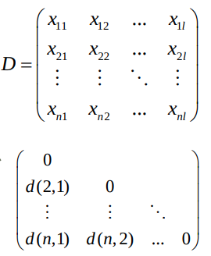
Similarity Measures for Cluster Analysis
Data Matrix and Dissimilarity Matrix
Data matrix
A data matrix of n data points with l dimensions
Dissimilarity (distance) matrix
n data points, but registers only the distance d(i, j) (typically metric)
Usually symmetric, thus a triangular matrix
Distance functions are usually different for real, boolean, categorical, ordinal, ratio, and vector variables
Weights can be associated with different variables based on applications and data semantics
9

Slide 10
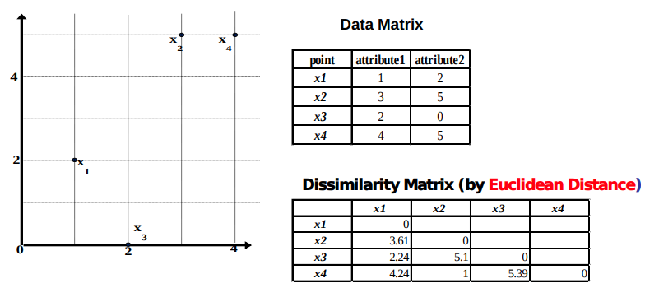
Similarity Measures for Cluster Analysis
Example: Data Matrix and Dissimilarity Matrix
10

Slide 11

Similarity Measures for Cluster Analysis
Distance on Numeric Data: Minkowski Distance
Minkowski distance: A popular distance measure
where i = (xi1, xi2, …, xil) and j = (xj1, xj2, …, xjl) are two l-dimensional data objects, and p is the order (the distance so defined is also called L-p norm)
Properties
d(i, j) > 0 if i ≠ j, and d(i, i) = 0 (Positivity)
d(i, j) = d(j, i) (Symmetry)
d(i, j) ≤ d(i, k) + d(k, j) (Triangle Inequality)
A distance that satisfies these properties is a metric
Note: There are nonmetric dissimilarities, e.g., set differences
11

Slide 12

Similarity Measures for Cluster Analysis
Special Cases of Minkowski Distance
p = 1: (L1 norm) Manhattan (or city block) distance
E.g., the Hamming distance: the number of bits that are different between two binary vectors
p = 2: (L2 norm) Euclidean distance
p → ∞: (Lmax norm, L∞ norm) “supremum” distance
The maximum difference between any component (attribute) of the vectors
12

Slide 13
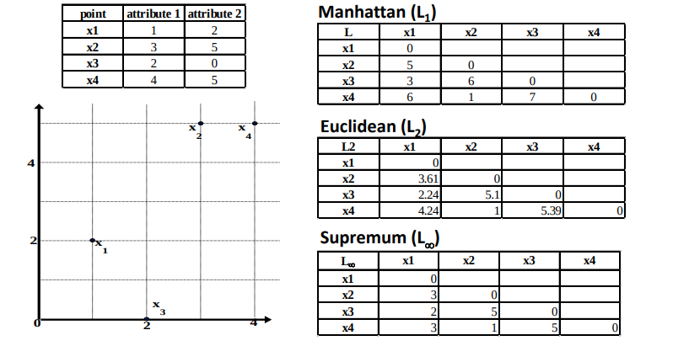
Similarity Measures for Cluster Analysis
Example: Minkowski Distance at Special Cases
13

Slide 14
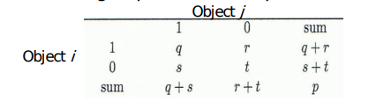
Similarity Measures for Cluster Analysis
Proximity Measure for Symmetric vs. Asymmetric Binary Variables
Binary data, where attributes can take one of two values, requires specific proximity measures to capture similarity.
A contingency table for binary data
14

Slide 15



Similarity Measures for Cluster Analysis
Proximity Measure for Binary Attributes
Distance measure for symmetric binary variables:
Distance measure for asymmetric binary variables:
Jaccard coefficient (similarity measure for asymmetric binary variables):
Note: Jaccard coefficient is the same as “coherence”: (a concept discussed in Pattern Discovery)
15

Slide 16
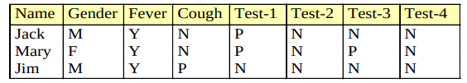
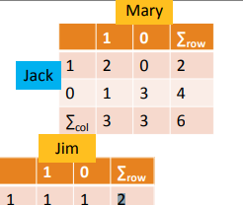

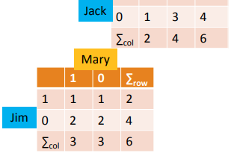
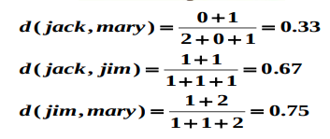
Similarity Measures for Cluster Analysis
Example: Dissimilarity between Asymmetric Binary Variables
Gender is a symmetric attribute (not counted in)
The remaining attributes are asymmetric binary
Let the values Y and P be 1, and the value N be 0
Distance:
16

Slide 17

Similarity Measures for Cluster Analysis
Distance between Categorical Attributes, Ordinal Attributes, and Mixed Types
Proximity Measure for Categorical Attributes
Categorical data, also called nominal attributes
Example: Color (red, yellow, blue, green), profession, etc.
Method 1: Simple matching
m: # of matches, p: total # of variables
Method 2: Use a large number of binary attributes
Creating a new binary attribute for each of the M nominal states
17

Slide 18


Similarity Measures for Cluster Analysis
Ordinal Variables
An ordinal variable can be discrete or continuous
Order is important, e.g., rank (e.g., freshman, sophomore, junior, senior)
Can be treated like interval-scaled
Replace an ordinal variable value by its rank:
Map the range of each variable onto [0, 1] by replacing i-th object in the f-th variable by
Example: freshman: 0; sophomore: 1/3; junior: 2/3; senior 1
Then distance: d(freshman, senior) = 1, d(junior, senior) = 1/3
Compute the dissimilarity using methods for interval-scaled variables
18

Slide 19
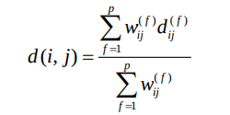

Similarity Measures for Cluster Analysis
Attributes of Mixed Type
A dataset may contain all attribute types
Nominal, symmetric binary, asymmetric binary, numeric, and ordinal
One may use a weighted formula to combine their effects:
If f is numeric: Use the normalized distance
If f is binary or nominal: dij (f) = 0 if xif = xjf; or dij (f) = 1 otherwise I
f f is ordinal
Compute ranks zif (where
Treat zif as interval-scaled
19

Slide 20
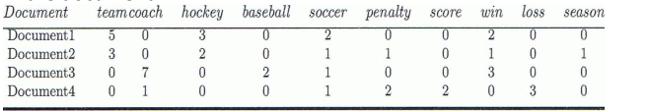
Similarity Measures for Cluster Analysis
Proximity Measure between Two Vectors: Cosine Similarity
A document can be represented by a bag of terms or a long vector, with each attribute recording the frequency of a particular term (such as word, keyword, or phrase) in the document
20

Slide 21

Similarity Measures for Cluster Analysis
Proximity Measure between Two Vectors: Cosine Similarity
Other vector objects: Gene features in micro-arrays
Applications: Information retrieval, biologic taxonomy, gene feature mapping, etc.
Cosine measure: If d1 and d2 are two vectors (e.g., term-frequency vectors), then
where • indicates vector dot product, ||d||: the length of vector d
21

Slide 22

Similarity Measures for Cluster Analysis
Example: Calculating Cosine Similarity
Ex: Find the similarity between documents 1 and 2.
d1 = (5, 0, 3, 0, 2, 0, 0, 2, 0, 0)
d2 = (3, 0, 2, 0, 1, 1, 0, 1, 0, 1)
First, calculate vector dot product
d1•d2 = 5 X 3 + 0 X 0 + 3 X 2 + 0 X 0 + 2 X 1 + 0 X 1 + 0 X 1 + 2 X 1 + 0 X 0 + 0 X 1 = 25
Then, calculate ||d1|| and ||d2||
Calculate cosine similarity: cos(d1, d2 ) = 26/ (6.481 X 4.12) = 0.94
22

Slide 23
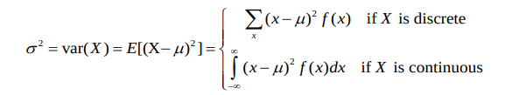

Similarity Measures for Cluster Analysis
Correlation Measures between Two Variables: Covariance and Correlation Coefficient
The variance of a random variable X provides a measure of how much the value of X deviates from the mean or expected value of X:
where σ2 is the variance of X, σ is called standard deviation
µ is the mean, and µ = E[X] is the expected value of X
That is, variance is the expected value of the square deviation from the mean
It can also be written as:
Sample variance is the average squared deviation of the data value xi from the sample mean
23

Slide 24


Similarity Measures for Cluster Analysis
Covariance for Two Variables
Covariance between two variables X1 and X2
where µ1 = E[X1] is the respective mean or expected value of X1; similarly for µ2
Sample covariance between X1 and X2:
Sample covariance is a generalization of the sample variance:
24

Slide 25
Similarity Measures for Cluster Analysis
Covariance for Two Variables
Positive covariance: If σ12 > 0
Negative covariance: If σ12 < 0
Independence: If X1 and X2 are independent, σ12 = 0 but the reverse is not true
Some pairs of random variables may have a covariance 0 but are not independent
Only under some additional assumptions (e.g., the data follow multivariate normal distributions) does a covariance of 0 imply independence
25

Slide 26

Similarity Measures for Cluster Analysis
Example: Calculation of Covariance
Suppose two stocks X1 and X2 have the following values in one week:
(2, 5), (3, 8), (5, 10), (4, 11), (6, 14)
Question: If the stocks are affected by the same industry trends, will their prices rise or fall together?
Covariance formula
Its computation can be simplified as:
E(X1) = (2 + 3 + 5 + 4 + 6)/ 5 = 20/5 = 4
E(X2) = (5 + 8 + 10 + 11 + 14) /5 = 48/5 = 9.6
σ12 = (2×5 + 3×8 + 5×10 + 4×11 + 6×14)/5 − 4 × 9.6 = 4
Thus, X1 and X2 rise together since σ12 > 0
26

Slide 27


Similarity Measures for Cluster Analysis
Correlation between Two Numerical Variables
Correlation between two variables X1 and X2 is the standard covariance, obtained by normalizing the covariance with the standard deviation of each variable
Sample correlation for two attributes X1 and X2:
where n is the number of tuples, µ1 and µ2 are the respective means of X1 and X2 , σ1 and σ2 are the respective standard deviation of X1 and X2
If ρ12 > 0: A and B are positively correlated (X1’s values increase as X2’s)
The higher, the stronger correlation
If ρ12 = 0: independent (under the same assumption as discussed in co-variance)
If ρ12 < 0: negatively correlated
27

Slide 28
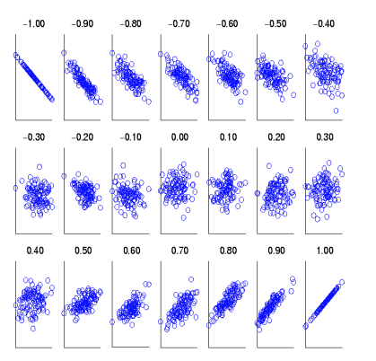
Similarity Measures for Cluster Analysis
Visualizing Changes of Correlation Coefficient
Correlation coefficient value range: [–1, 1]
A set of scatter plots shows sets of points and their correlation coefficients changing from –1 to 1
28

Slide 29
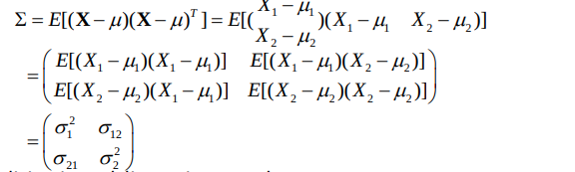
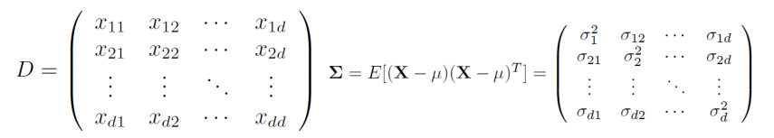
Similarity Measures for Cluster Analysis
Covariance Matrix
The variance and covariance information for the two variables X1 and X2 can be summarized as 2 X 2 covariance matrix as
Generalizing it to d dimensions, we have,
29

Slide 30
Similarity Measures for Cluster Analysis
Selecting the Right Similarity Measure
Guidelines for Selecting a Similarity Measure:
Numeric Data: Choose distance metrics based on data distribution (e.g., Minkowski, Euclidean, Manhattan).
Binary Data: Select Jaccard or Tanimoto coefficients based on symmetry and attribute importance.
Categorical Data: Use Hamming distance for unordered categories.
Ordinal Data: Apply Spearman's Footrule for ranked attributes.
Mixed Data: Choose measures based on attribute types and characteristics.
By adhering to these guidelines, you ensure that your chosen similarity measure aligns with your data's nature and analysis goals.
30

Slide 31
Similarity Measures for Cluster Analysis
Applications and Limitations of Similarity Measures
Each similarity measure has its strengths and limitations, influencing its suitability for specific scenarios.
Applications:
Minkowski distance for numeric data with varied scales.
Jaccard and Tanimoto coefficients for binary data with different attribute weights.
Hamming distance for categorical data without a natural order.
Spearman's Footrule for ordinal attributes with ranking information.
Cosine similarity for vector-based data like text documents.
Correlation measures for capturing linear relationships between variables.
31

Slide 32
Similarity Measures for Cluster Analysis
Applications and Limitations of Similarity Measures
Limitations:
Minkowski distance is sensitive to attribute scales.
Jaccard and Tanimoto may not consider attribute importance equally.
Hamming and Spearman's Footrule require distinct data types.
Cosine similarity assumes vector space representation.
Correlation measures may not capture nonlinear relationships.
Understanding the applications and limitations of similarity measures guides their appropriate use in diverse clustering scenarios.
32

Slide 33
Similarity Measures for Cluster Analysis
Case Study: Customer Segmentation
Objective:
Divide customers into segments based on their purchasing behavior.
Uncover distinct patterns and preferences within the customer base.
Steps:
Data Preprocessing: Prepare customer purchase history data.
Feature Extraction: Convert purchase history into numerical representation.
Similarity Measurement: Choose an appropriate metric (e.g., cosine similarity).
Clustering Algorithm: Apply K-Means clustering to group similar customers.
Interpretation: Analyze cluster characteristics and formulate insights.
33

Slide 34
Similarity Measures for Cluster Analysis
Recap and Key Takeaways
Basic concepts of measuring similarity guide cluster formation and pattern discovery.
Distance metrics like Minkowski, Jaccard, Hamming, and Spearman's Footrule cater to diverse data types.
Cosine similarity quantifies direction in vector-based data.
Correlation measures reveal linear relationships between variables.
Practical considerations and domain knowledge guide measure selection.
34

Slide 35
Summary
Similarity Measures
Crucial for clustering to group similar data.
Metrics for numeric, binary, categorical, and mixed data.
Includes cosine similarity and correlation measures.
35

